Slide 1
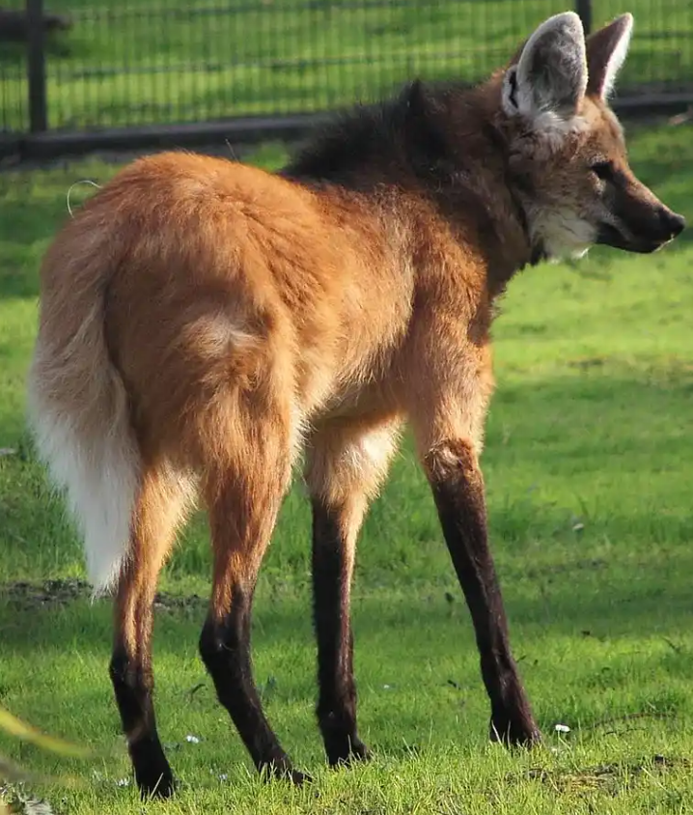
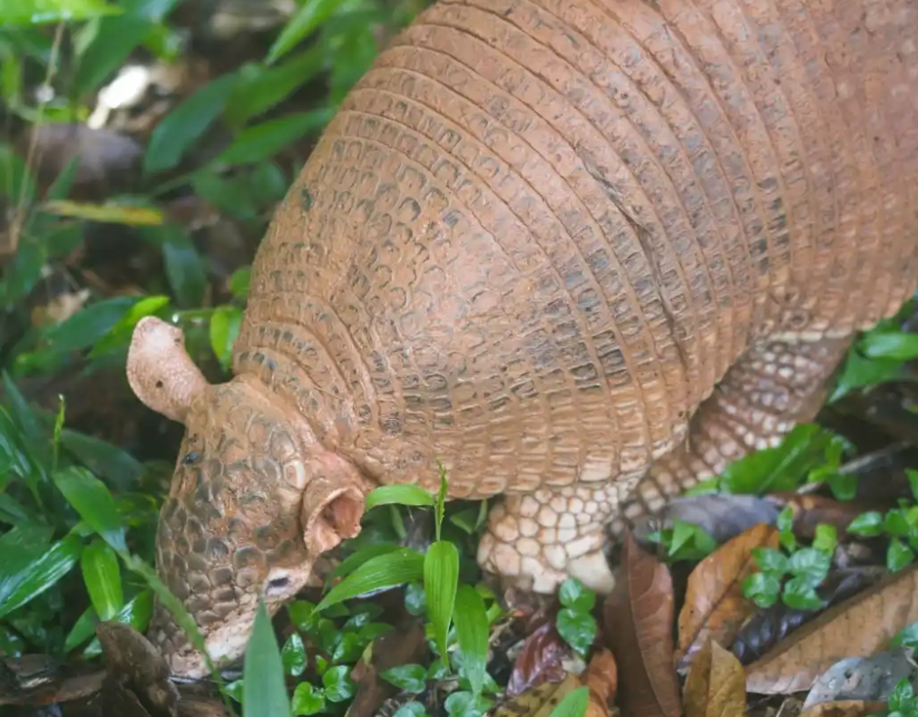
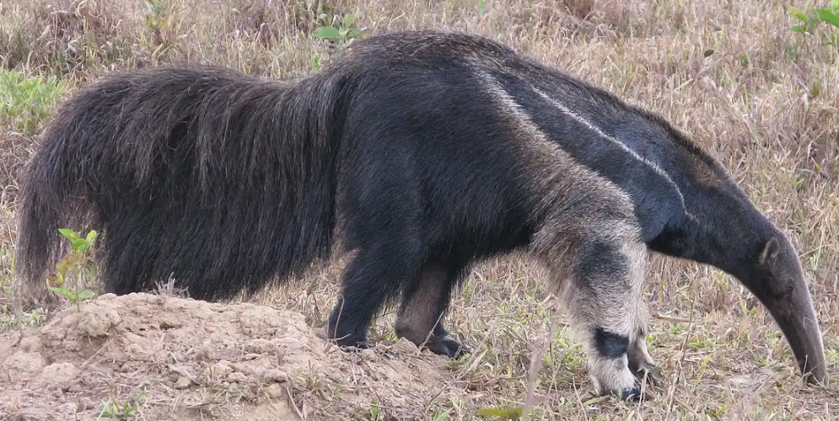
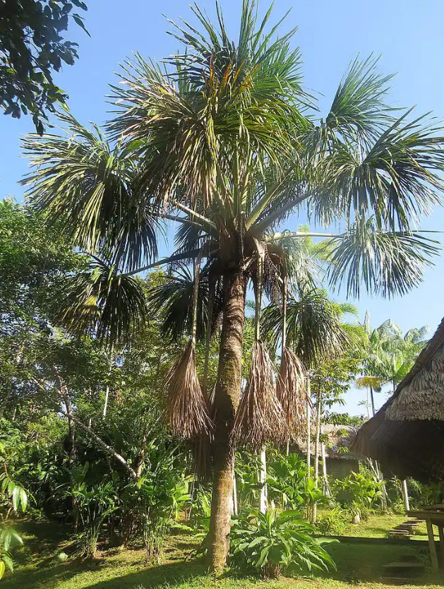
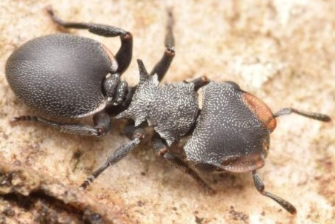
Maned Wolf, tertiary consumer
Predation
Predation
Giant Anteater, secondary consumer
Giant Armadillo, secondary consumer
Trophic Cascade
Competition
Trophic Cascade
Predation
Trophic Cascade
Predation
Buriti Tree
(Mauritia flexuosa), Producer, focal species
Turtle Ant, primary consumer
Predation, parasitism

Slide 2
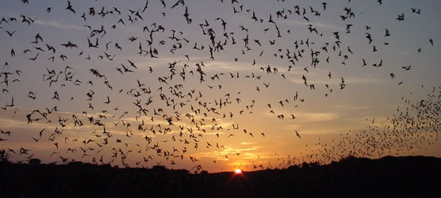
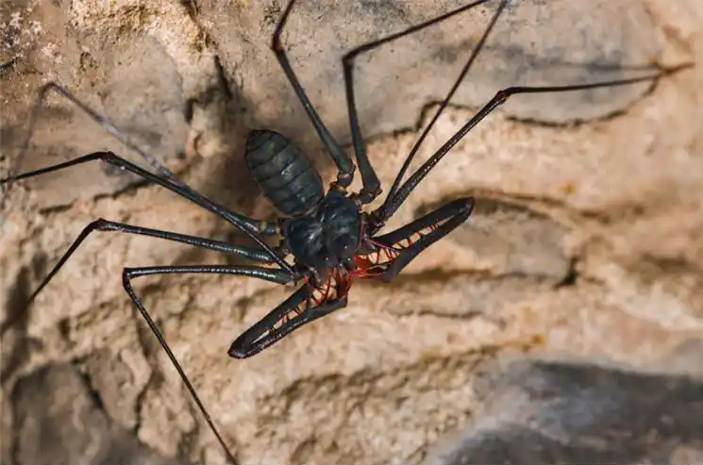
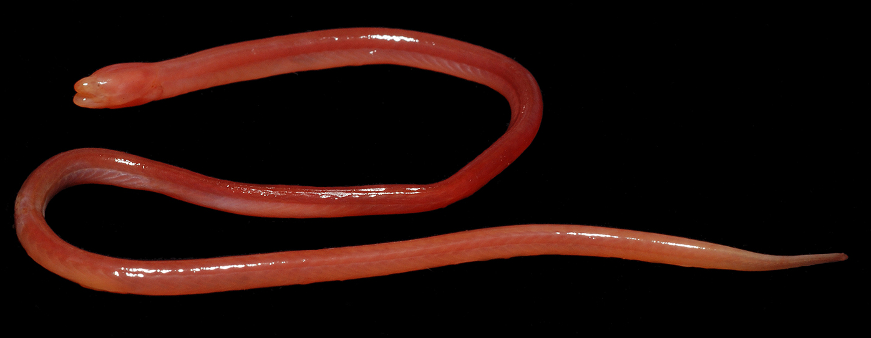

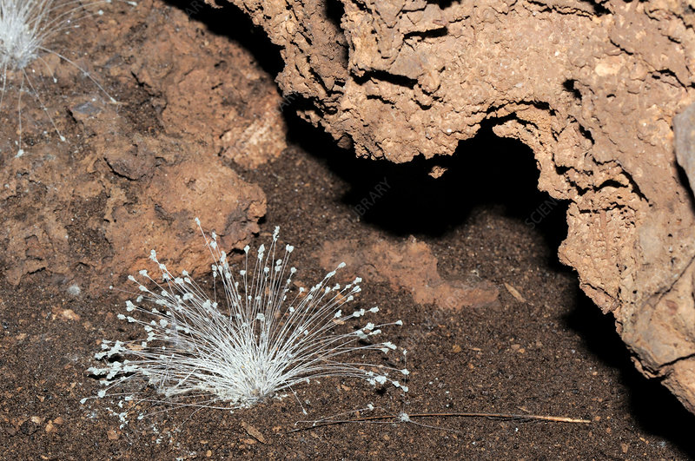
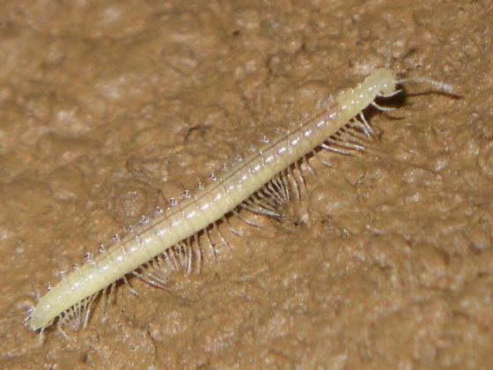
Mexican free-tailed bat, focal species, secondary consumer
Whip scorpion, secondary consumer
Blind swamp eel, decomposer
Habitat facilitation
Defecates
Habitat facilitation
Predation
Keystone predation
Predation
Cave fungi, decomposer
Predation
Guano
Predation
Competition
Millipede, decomposer

